Slide 1
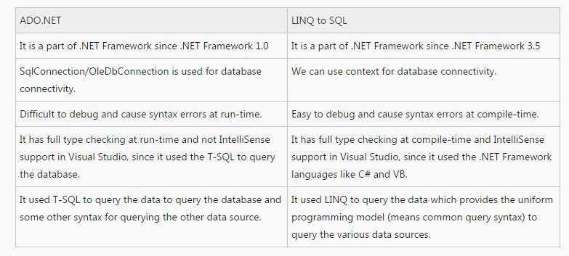
Difference between ADO.NET and LINQ to SQL

